Slide 1

Travel assured
Customer data analysis

Slide 2
Questions and data description
What are the travel habits between customers and non-customers?
Do customers tend to travel more often (buying tickets from frequent flyer miles) and travel abroad?
Variable | Value | Variable | Value
Size | 1987 entries | Chronic Diseases | 552 (27.8% of total)
Ages | 25 – 35 years old | Travelled Abroad | 380 (19.1% of total)
Income | $300,000 – $1,800,000 | Private Sector | 1417 (71.3% of total)
Family Members | 2 – 9 people | Frequent Flyer | 417 (21.0% of total)
Travel Insurance | 710 insured (35.7% of total) | Graduate | 1692 (85.2% of total)

Slide 3
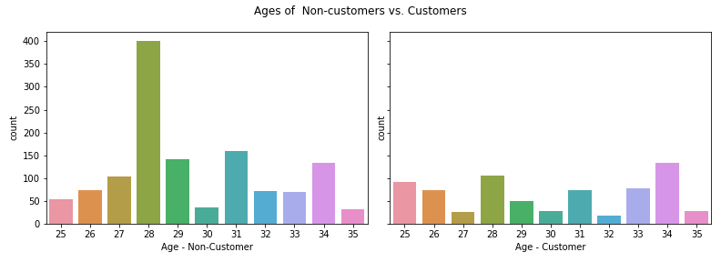
Age distribution by insured status

Slide 4
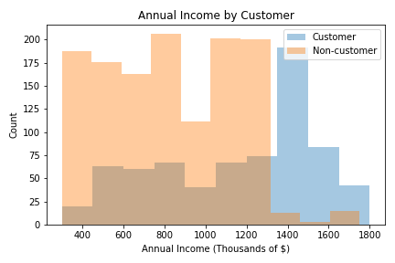
Insured status by annual income
INCOME > $1,300,000:
91.12% ARE CUSTOMERS
INCOME < $1,300,000:
77% ARE NOT CUSTOMERS

Slide 5
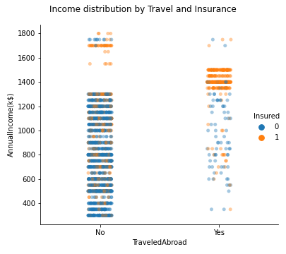
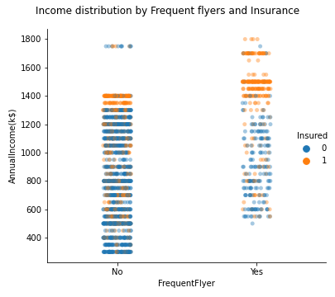
TRAVELED ABROAD & FREQUENT FLYERS

Slide 6
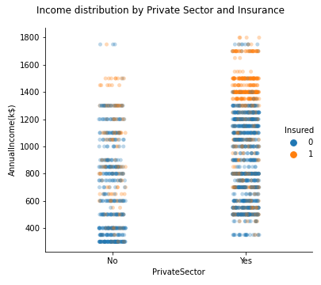
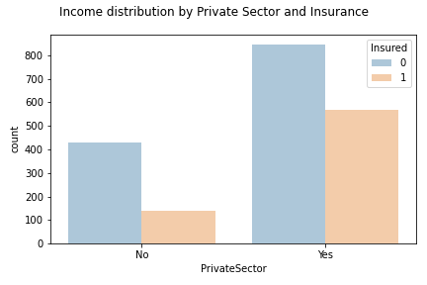
PRIVATE SECTOR VS. GOVERNMENT SECTOR
75.4% of Government sector travelers are not customers

Slide 7
conclusion
RECOMMENDED AREAS OF OPPORTUNITY:
Travelers with AN ANNUAL income less than $1,300,000
76.92% ARE NOT CUSTOMERS
Younger travelers (28 year olds)
79.25% ARE NOT CUSTOMERS
Government sector travelers
75.4% ARE NOT CUSTOMERS

